Slide 1
Actionscript 3.0 Basics
2 – Event-driven Programming

Slide 2
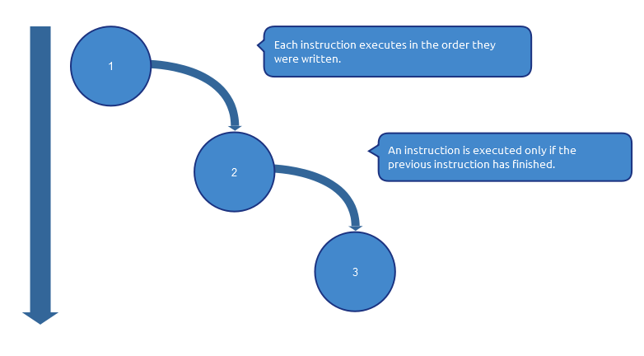
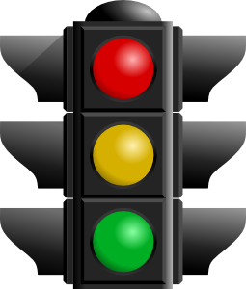
Synchronous Programming

Slide 3
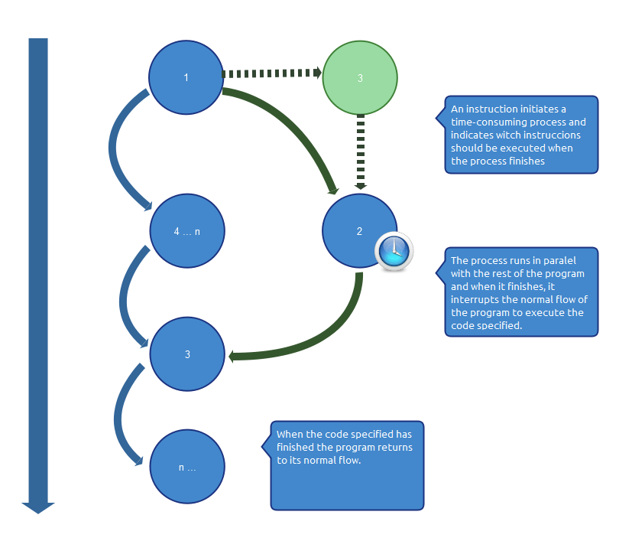
Asynchronous Programming

Slide 4
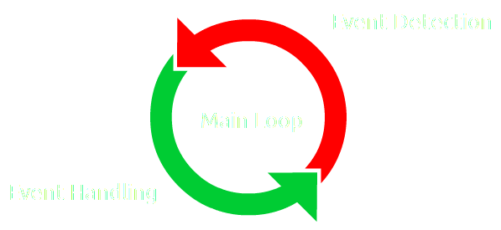

Event-Driven Programming
Is a programming paradigm in which the flow of the program is determined by events or messages from other programs or threads.
Event-driven programming can also be defined as an application architecture technique in which the application has a main loop which is clearly divided down to two sections: the first is event selection (or event detection), and the second is event handling.
[ http://en.wikipedia.org/wiki/Event-driven_programming ]

Slide 5
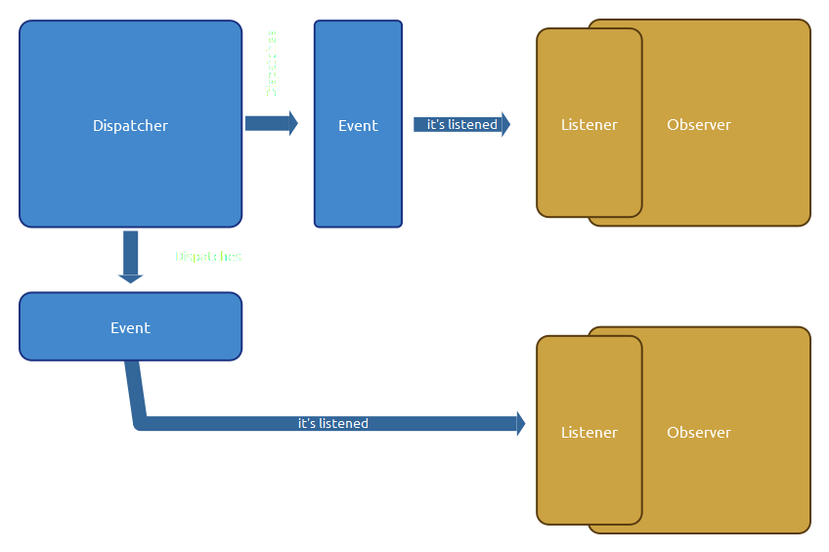
Observer-Dispatcher Pattern

Slide 6
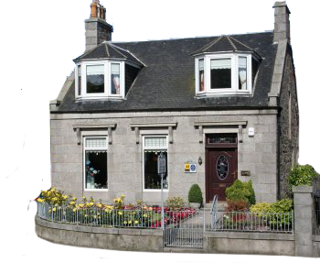

Observer-Dispatcher Pattern

Slide 7
Flash Event System
<<interface>>
flash.events.IEventDispatcher
flash.events.EventDispatcher
flash.events.Event
EventDispatcher(
target:IEventDispatcher = null)
addEventListener(
type:String,
listener:Function,
useCapture:Boolean = false,
priority:int = 0,
useWeakReference:Boolean = false):void
dispatchEvent(event:Event):Boolean
hasEventListener(type:String):Boolean
removeEventListener(
type:String,
listener:Function,
useCapture:Boolean = false):void
willTrigger(type:String):Boolean
bubbles : Boolean
cancelable : Boolean
currentTarget : Object
eventPhase : uint
target : Object
type : String
Event(
type:String,
bubbles:Boolean = false,
cancelable:Boolean = false)
clone():Event
formatToString(className:String,
... arguments):String
isDefaultPrevented():Boolean
preventDefault():void
stopImmediatePropagation():void
stopPropagation():void

Slide 8

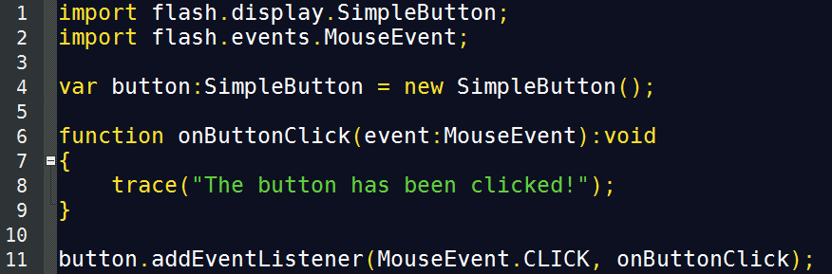


Flash Event System
Dispatcher
Listener
(Event Handling)
Event Subscription

Slide 9
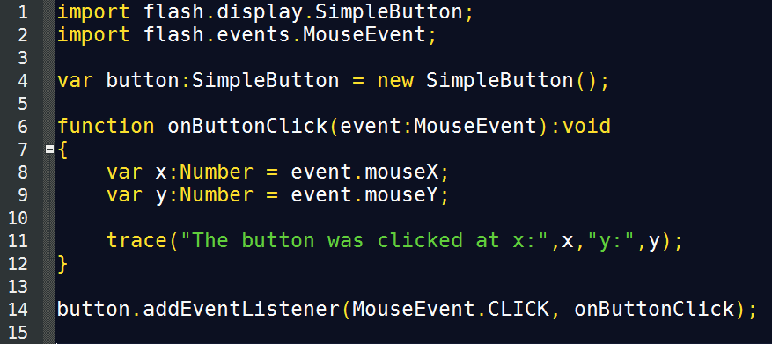
Flash Event System
Event Data

Slide 10
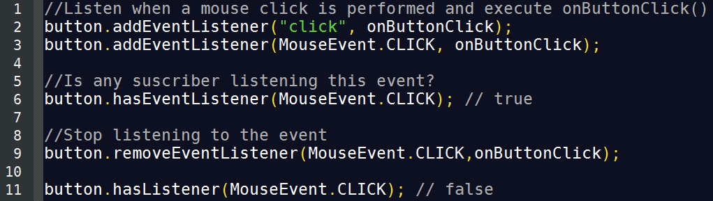
Flash Event System

Slide 11
Flash Event System
Responsibility Distribution
Flash Event System
Native Events > Flash Event System
Custom Events > Developer
Developer

Slide 12
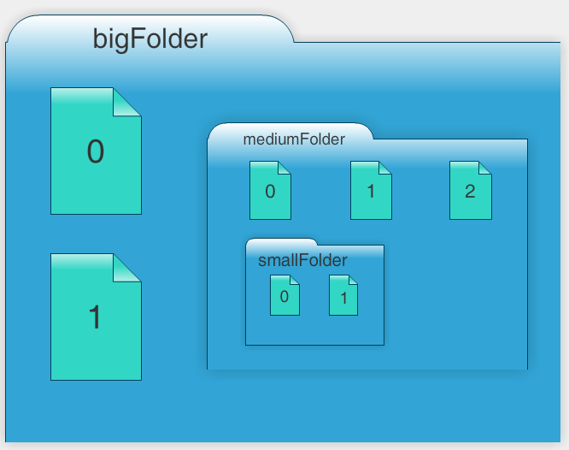
Event Propagation
Document Object Model
<root>
BigFolder
0
1
MediumFolder
0
1
2
SmallFolder
0
1
Contains

Slide 13
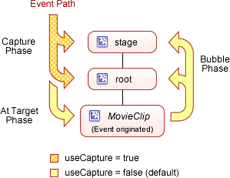
Event Propagation
Event Phases
Event Path
Capture
Phase
Bubble
Phase
At Target
Phase

Slide 14
Event Propagation
Event Phases

Slide 15
Event Propagation
Event Phases

Slide 16
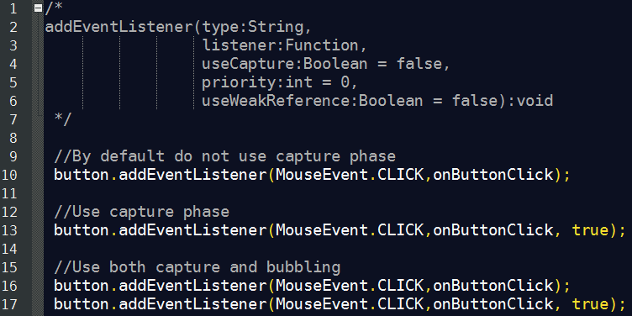
Event Propagation
Event Phases

Slide 17
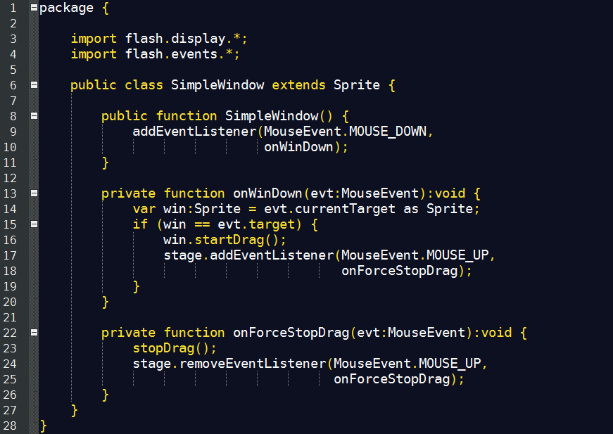
Event Propagation
Event Targets

Slide 18
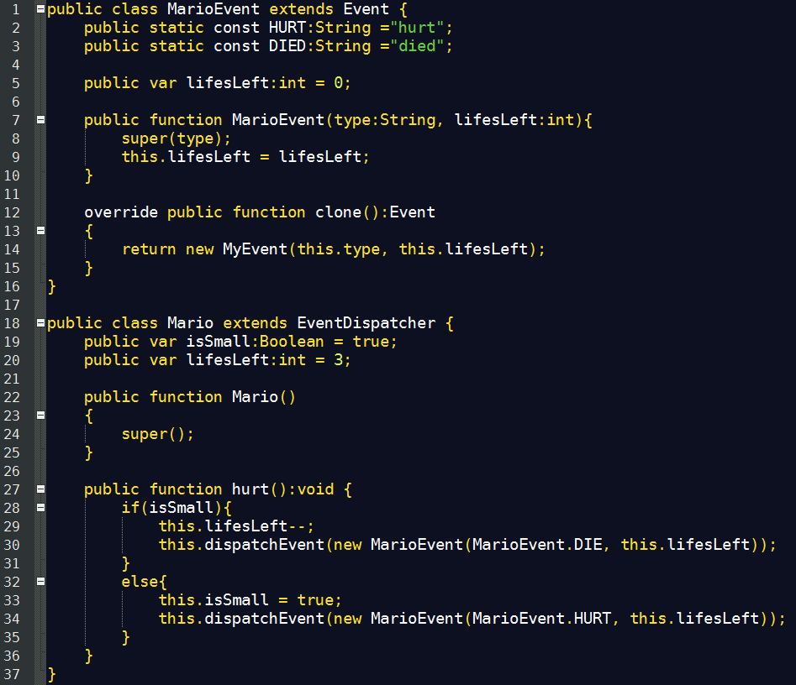
Custom Events
Custom Event
Event Name Constants
Custom Dispatcher
Event Detection

Slide 19
Advantages
Promotes decoupling and encapsulation of objects.
Cleaner code, consistent with flash apis.
Faster since it's implemented as a native language feature.
Standard, consistent with many language implementations.

Slide 20
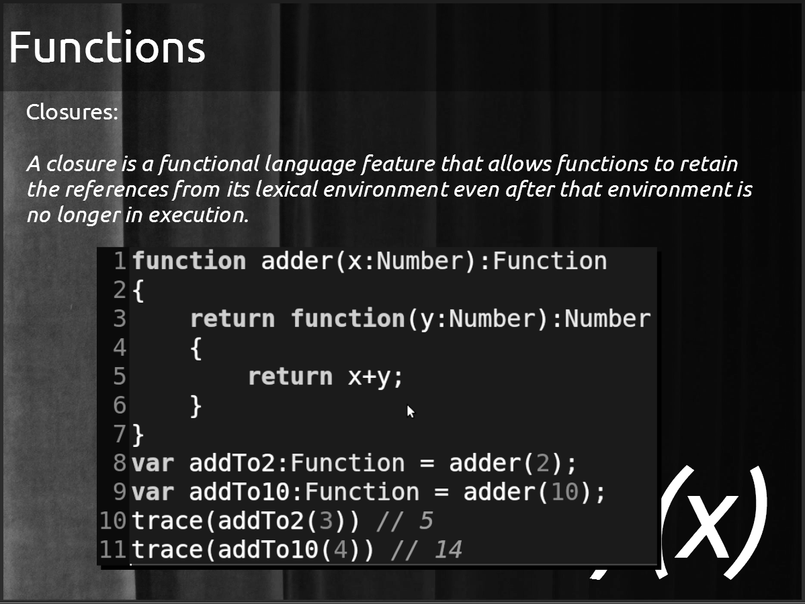

Slide 21
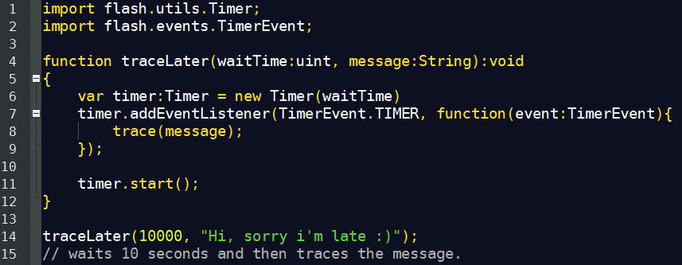
Events + Closures

Slide 22
Thanks!
github.com/matix/as3basics
matias.figueroa@globant.com
@matixfigueroa

